Slide 1


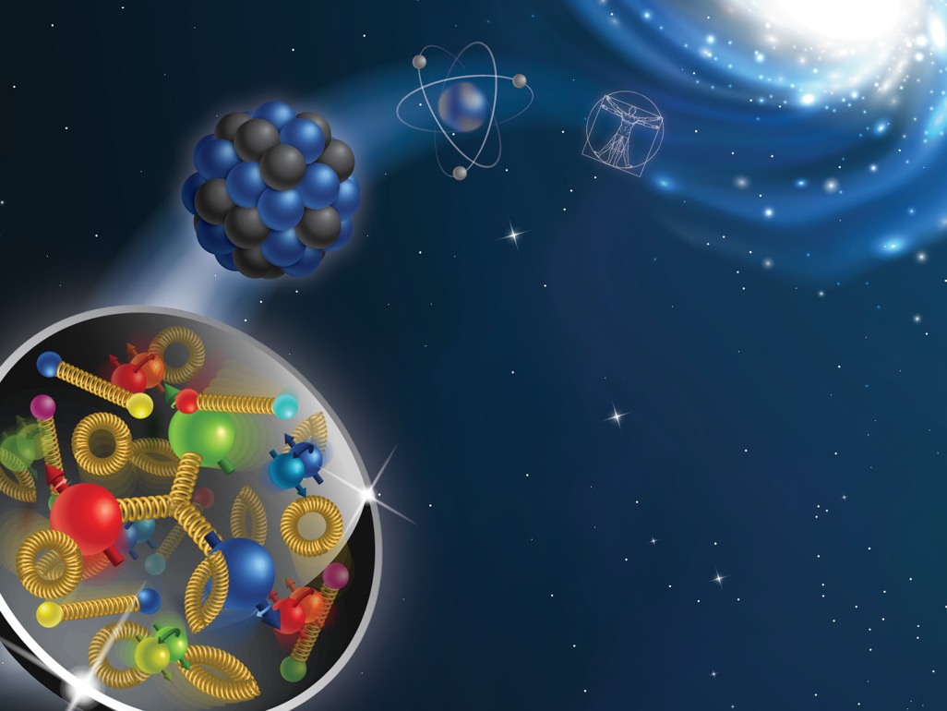
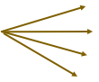





Regions of pion production in Semi-Inclusive Deep Inelastic Scattering
S. Dolan¹, L. Gamberg¹, A. Prokudin^{1,2}, M. Boglione³, M. Diefenthaler², W. Melnitchouk², D. Pitonyak⁴, T. Rogers^{2,5}, N. Sato²
¹ Division of Science, Penn State University Berks, Reading, PA, ² Theory Center, Jefferson Lab, Newport News, VA, ³ University of Turin, Italy, ⁴ Lebanon Valley College, PA ⁵ Old Dominion University, Norfolk, VA
introduction
The SELECTION CRITERIA
DATA Analysis
Protons and neutrons (nucleons), which make up the nucleus of an atom, are not fundamental constituents of matter, but are themselves made up of particles called quarks. These quarks are “glued” together by the strong nuclear force, which is mediated by another particle called the gluon. Collectively quarks and gluons are called partons. Any particle containing quarks is called a hadron. Moreover, the quarks are not static inside of a nucleon – they have an intrinsic momentum even for a nucleon at rest. Understanding the underlying structure of the nucleon in terms of partons is one of the central goals of modern nuclear physics. Partons are not directly accessible by experiment, but rather experimental measurements are related by factorization theorems to functions that describe partonic structure of the nucleon.
One of the ways to access intrinsic motion is through a process called semi-inclusive deep inelastic scattering (SIDIS). In this reaction, a high-energy electron scatters off a quark within the nucleon. This quark forms a hadron in the final-state (e.g., a pion), which is detected along with the scattered electron (see Fig. 1).
In general, pions in this reaction are produced from the fragmentation of the struck quark (current region), remnants of the struck nucleon (target region), or from gluons radiated in the process, Ref. [1]. In this figure we show regions of pion production in rapidity, y, and transverse momentum q_{T}=P_{T}/z_{h} plane:
In our study we determine the portion of the data that corresponds to the current fragmentation region. Typical variables for SIDIS are: x_{Bj} - Bjorken variable, momentum fraction of the proton momentum carried by the quark, z_{h} - a similar variable for the produced hadron, P_{T} is measured transverse momentum of the produced hadron in the photon-proton center of mass frame, Q – the virtuality of the exchanged photon, y – rapidity variable.
Each region has significant experimental and theoretical interest, and each is important for understanding the nucleon structure. The precise demarcation of these regions is not exactly known yet and is needed for phenomenological study of the nucleon structure. One region of the major interest is the Transverse Momentum Dependent (TMD) current fragmentation region. It allows to map three-dimensional structure of the nucleon. The future facilities, such as the Electron-Ion Collider, aim at unraveling three-dimensional stricture of the nucleon via TMD related measurements. TMD factorization theorem receives corrections in terms of powers $δ\sim \frac{P_{T}}{z_{h}Q}$. The purpose of this project is to identify the regions of pion production for SIDIS indicated in Fig. 1. Recently, in Ref. [2] we introduced ratio criteria, R₀, R₁, R₂ for the various regions in SIDIS. Each ratio is a function of the underlying parton kinematics. If all R₀, R₁, R₂ $≪$1, then the corresponding region of the data is the TMD current fragmentation region.
In Fig. 2 the TMD current fragmentation region is estimated for the future Electron-Ion Collider [3] kinematics at the energy of 140 GeV.
The kinematical bins for the EIC in terms of x_{Bj} and Q² are shown in Fig. 2. In each kinematical bin we show a panel with possible measured bins in P_{T} and z_{h} . The so-called affinity to TMD factorization region (i.e. the probability that the data can be described by TMD factorization) is calculated for each bin of the EIC measurements. The affinity represents a probability of the bin to belong to TMD factorization region and spans from 0% to 100%, indicated by the color and the symbol size. Affinity of each bin to the TMD current region of SIDIS is estimated by performing Monte Carlo sampling of parton kinematics and ratios R₀, R₁, R₂. This estimate provides an intuitive tool to identify the data associated with TMD physics. One can see from Fig. 2 that the bins with relatively large z_{h}, x_{Bj}, and Q² are especially important for TMD factorization description. The rest of the data will be important for descriptions in other types of factorization, for instance for the QCD collinear factorization.
Figure 1: Schematic diagram of semi-inclusive deep inelastic scattering (SIDIS): a high-energy electron knocks a quark out of the nucleon. The quark or spectators from the proton forms a pion in the final state, which is detected along with the scattered electron.
Figure 2: Future EIC data bins as a function of P_{T} and z_{h}. The color bar represents the affinity to the TMD region.
Figure 3: Sketch of kinematical regions of SIDIS in terms of the produced hadron’s Breit frame rapidity and transverse momentum. In each region, the type of suppression factors that give factorization are shown. From Ref.[2].
$$l′$$
}
$$l$$
Target
fragmentation
region
$$N$$
}
Current
fragmentation
region
Conclusions and outlook
Acknowledgements
We have successfully applied the ratio criteria, R₀, R₁, R₂, proposed in Ref. [2], to future SIDIS data. Moreover, we have shown that the region of applicability of TMD factorization is compatible with naïve expectations, namely, low P_{T} region and large z_{h} . The next step of our analysis will be include a phenomenological fit of the data and extraction of the underlying TMDs. We will also investigate the influence of the choice of parton kinematics on the ratios, and the subsequent determination of TMDs.
The tool that we have developed will help to demarcate regions of pion production in SIDIS and will be useful for both experimental and phenomenological communities of hadron physics and help sharpen the physics program of the EIC project.
We would like to acknowledge support from NSF under Contracts No. PHY-2012002(AP, SD), PHY-2011763 (DP) and DOE under Contract No. DE-FG02-07ER41460 (LG), and TMD Collaboration within DOE topical collaboration grant.
[1] M. Boglione, et al., Phys. Lett. B766, 245-253 (2017)
[2] M. Boglione, et al., JHEP 10, 122 (2019)
[3] A. Accardi, et al., Eur.Phys. J.A52, 268 (2016)

